Slide 1
Exoplanet Demographics
Sydney Petz, Aiden Zelakiewicz, Justin Anderson
Notes:
Exoplanet demographics and method sensitivities
All of this conducted with data from NASA Exoplanet Archive

Slide 2
WHY?
What’s our motivation for examining these extrasolar planets’ demographics?
Notes:
Goals were to understand distribution of exoplanets into different parameter spaces
Detection limit of different techniques with state of the art technology
Knowing the limit will help us understand the biases involved in each method
Knowing these biases will help us know how to focus time and money moving forward

Slide 3
5,243 planets
have been discovered to date. The NASA Exoplanet Archive provides detection methods, mass, radius, and more for each planet.
Notes:
5,243 extrasolar planets have been discovered to date
NEA provided all relevant information like methods, mass, radius, and more for each planet and this allowed us to determine detection limits and calculate needed information

Slide 4
Exoplanet Detection: Three Primary Methods
Transit Photometry
Radial Velocity
Direct Imaging
Notes:
Three primary methods of detection: Transit Photometry, radial velocity, and direct imaging
We chose these methods due to them having the highest number of detected planets out of the 5,243

Slide 5
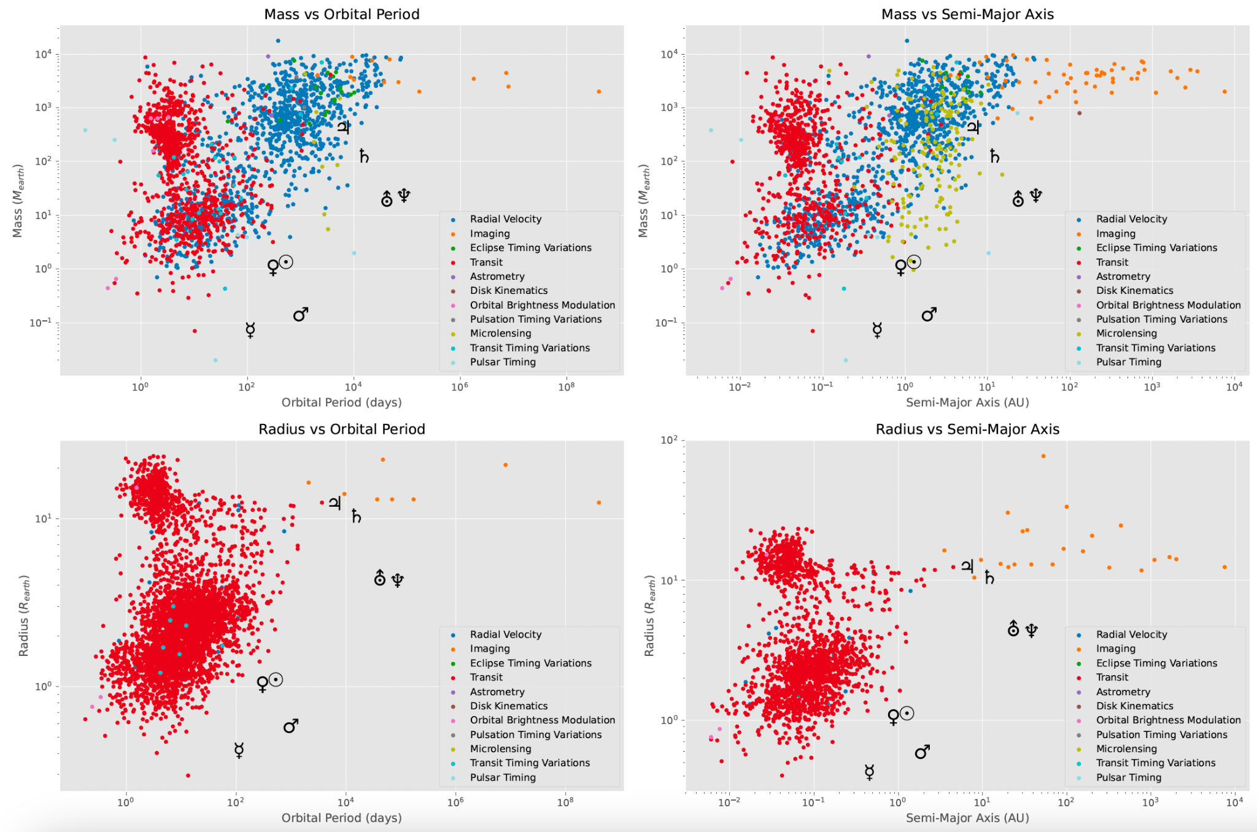
Notes:
With the Mass vs orbital period plot we can see a grouping of high mass planets in the blue radial velocity color

Slide 6
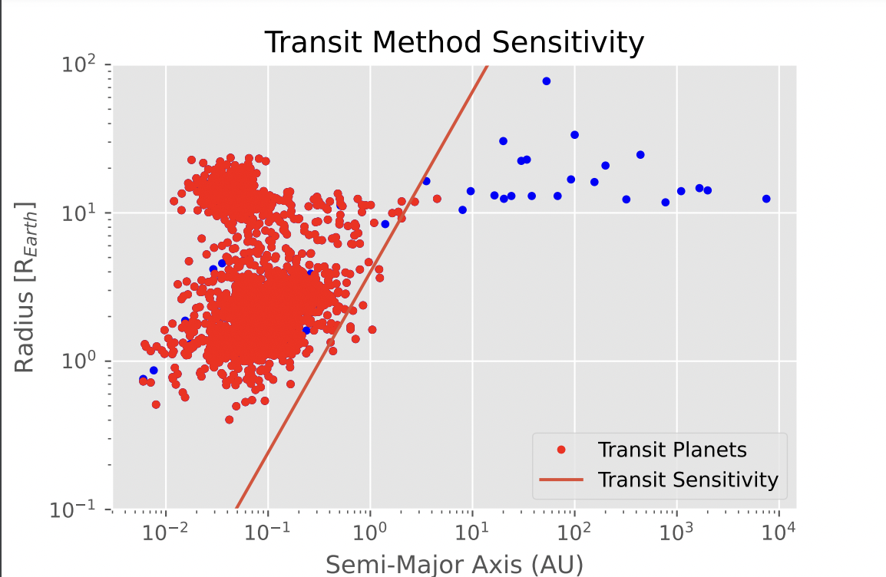
Transit Photometry Sensitivity
Notes:
We are sensitive to tight bound planets that are going to have a chance to transit multiple times

Slide 7
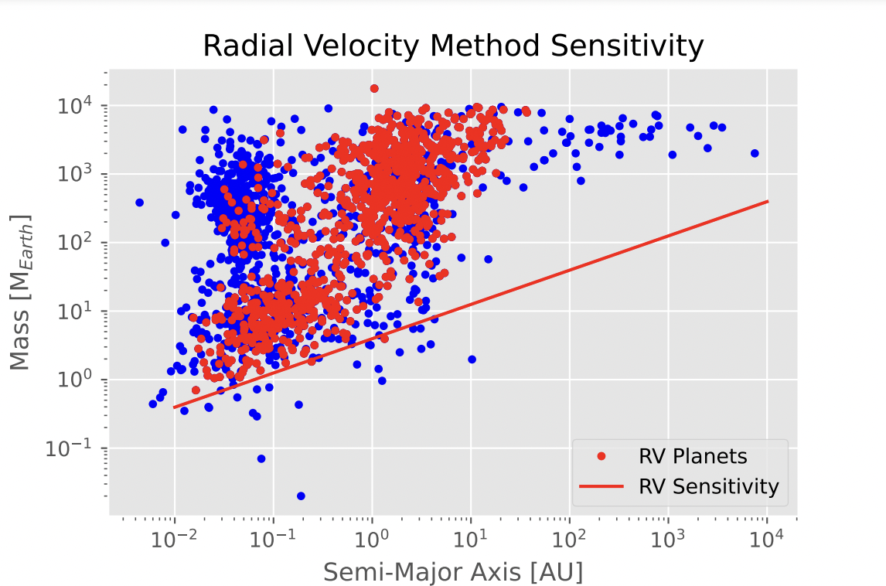
Radial Velocity Sensitivity
Notes:
Radial velocity is dependent on the gravitational pull between the host star and the orbiting planet, so as a planet gets farther away the subsequent mass of the planet must also increase because the gravitational force drops off with distance.

Slide 8
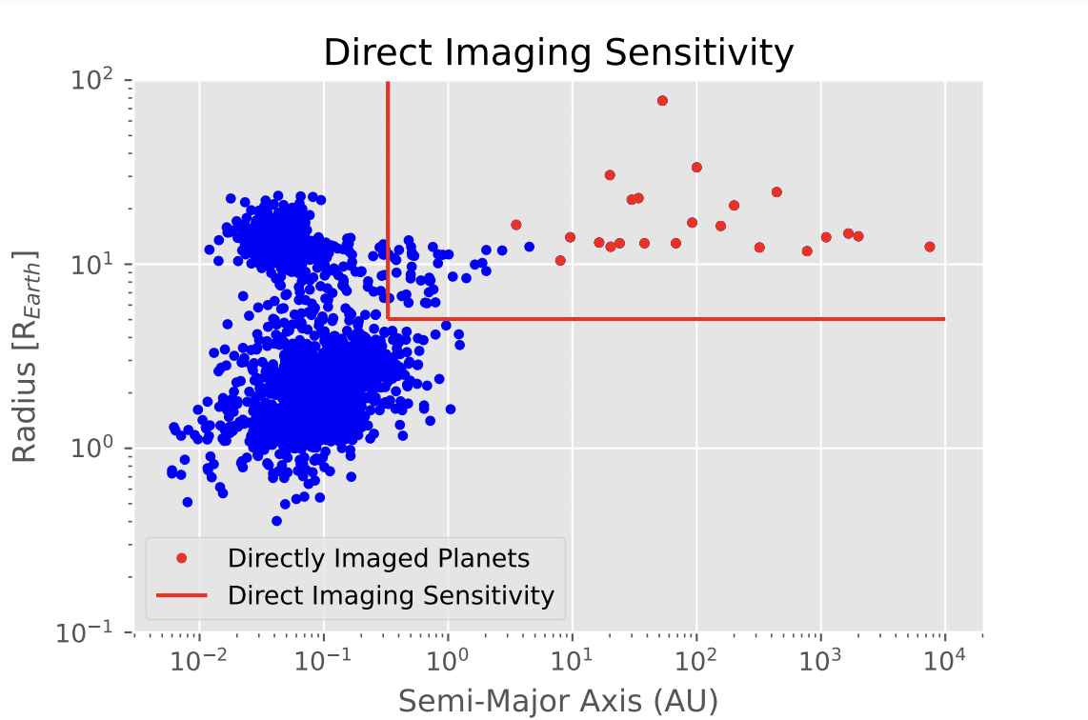
Direct Imaging Sensitivity
Notes:
We are sensitive to large planets that have large orbital periods because you need to be able to distinguish between them and the star or you will not be able to resolve them

Slide 9
Detection signal: Earth-like planet around a solar-type star

Slide 10
Transit
Radial Velocity
Direct Imaging
SNR = 2.9
NOT DETECTABLE
K = 0.089 m/s
NOT DETECTABLE
C = 8.0x10⁻⁸
NOT DETECTABLE
Notes:
SNR = signal to noise
K = radial velocity amplitude
C = contrast between planet and star

